Slide 1

WELCOME TO THE
2012
MOELLER HIGH SCHOOL
NAMED SCHOLARSHIP BREAKFAST
Notes:
Notes here…

Slide 2
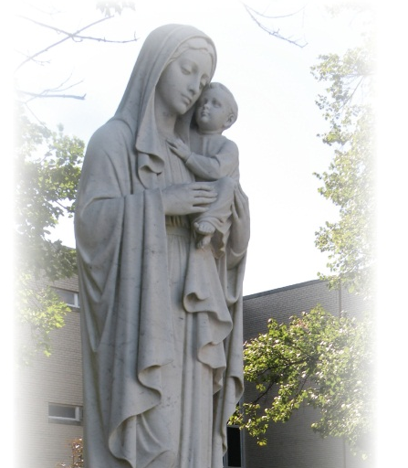
Thomas & Shirley Bohmer Scholarship
This scholarship will be awarded to a student with demonstrated
financial need. The reward will be renewed each year if the student remains on the Honor Roll, participates in at least one
co-curricular activity, and continues
to demonstrate financial need. ($5,200)
Notes:
Annual Fund Budget Goal: $1M. Measurable Objectives: Five appointments per week; AF One Call Thank You(s); AF Committee Strategic Plan; Faculty-Staff Assistance; Parent Pride; AF Brochure; AF email reminders; President’s Dinner; AF Envelope in Magazines; AF Christmas Card; AF Letters/Postcards. Athletic Fundraising Budget Goal $100K. Measurable Objective: Plan and Execute Athletic Development Strategic Plan.

Slide 3
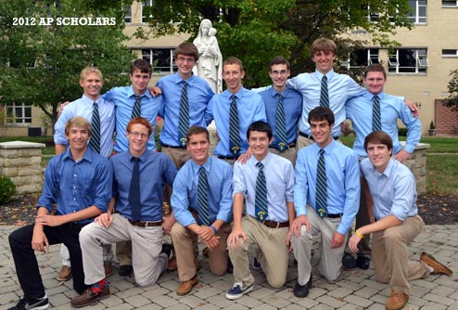
Daniel J. Buckley ‘91 Scholarship
This scholarship is awarded to one family with three or
more children in Catholic elementary or high schools and
has demonstrated financial need. ($2,500)
Notes:
Annual Fund Budget Goal: $1M. Measurable Objectives: Five appointments per week; AF One Call Thank You(s); AF Committee Strategic Plan; Faculty-Staff Assistance; Parent Pride; AF Brochure; AF email reminders; President’s Dinner; AF Envelope in Magazines; AF Christmas Card; AF Letters/Postcards. Athletic Fundraising Budget Goal $100K. Measurable Objective: Plan and Execute Athletic Development Strategic Plan.

Slide 4
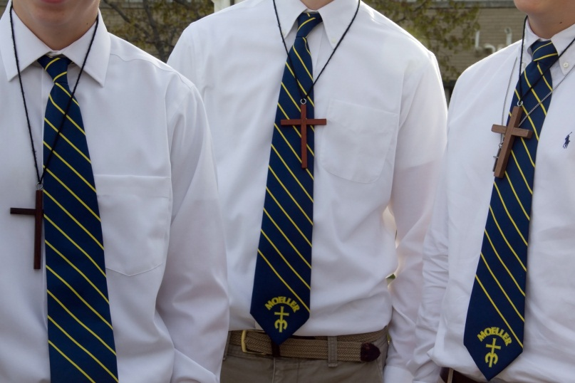
Curran Family Scholarship
This scholarship will be awarded to a student who participates
in at least one co-curricular activity, who is committed
to community service and pastoral ministries, and has
demonstrates financial need. This scholarship is renewable
if the criterion is met. ($10,000, multiple awards)
Notes:
Annual Fund Budget Goal: $1M. Measurable Objectives: Five appointments per week; AF One Call Thank You(s); AF Committee Strategic Plan; Faculty-Staff Assistance; Parent Pride; AF Brochure; AF email reminders; President’s Dinner; AF Envelope in Magazines; AF Christmas Card; AF Letters/Postcards. Athletic Fundraising Budget Goal $100K. Measurable Objective: Plan and Execute Athletic Development Strategic Plan.

Slide 5
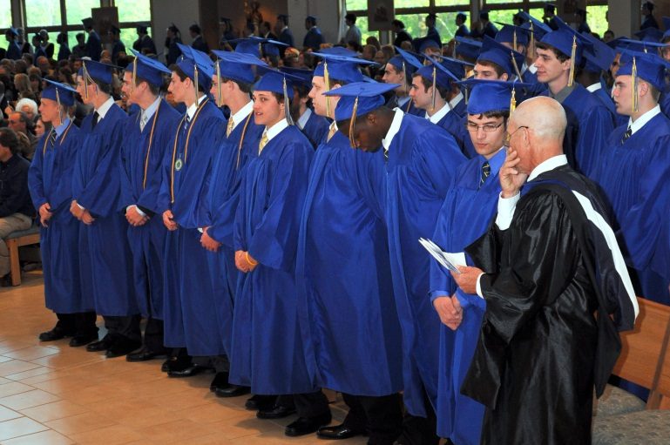
The Catino Family Scholarship
This scholarship will be awarded to a student with demonstrated
financial need. Recipients must score in the
90th percentile or higher on the Moeller Placement Exam
and demonstrate academic excellence at the gradeschool
level. This scholarship is renewable based on maintaining
First Honors and demonstrating financial need.
($75,000 total award, multiple scholarships awarded)
Notes:
Annual Fund Budget Goal: $1M. Measurable Objectives: Five appointments per week; AF One Call Thank You(s); AF Committee Strategic Plan; Faculty-Staff Assistance; Parent Pride; AF Brochure; AF email reminders; President’s Dinner; AF Envelope in Magazines; AF Christmas Card; AF Letters/Postcards. Athletic Fundraising Budget Goal $100K. Measurable Objective: Plan and Execute Athletic Development Strategic Plan.

Slide 6
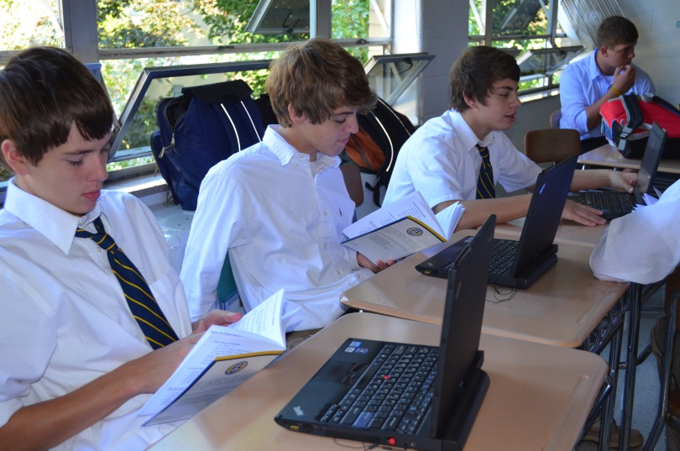
Christopher Michael ‘08 and
Blake Peter ‘13 Chambliss Scholarship
This scholarship will be awarded to a deserving student who is service oriented, participates in at least one co-curricular activity, and demonstrates financial need. ($1,000)
Notes:
Annual Fund Budget Goal: $1M. Measurable Objectives: Five appointments per week; AF One Call Thank You(s); AF Committee Strategic Plan; Faculty-Staff Assistance; Parent Pride; AF Brochure; AF email reminders; President’s Dinner; AF Envelope in Magazines; AF Christmas Card; AF Letters/Postcards. Athletic Fundraising Budget Goal $100K. Measurable Objective: Plan and Execute Athletic Development Strategic Plan.

Slide 7
Jim Champlin ‘72 Trinity House Scholarship
This scholarship was established in honor of Jim “Champ”
Champlin, Trinity House Dean and Moeller Religion Teacher.
This scholarship will be awarded to a Trinity House
student who exemplifies the Trinity House characteristics
of brotherhood, unity, and Christian values, and who has
demonstrated financial need. This scholarship is renewable
as long as the student remains on the Honor Roll and
continues to meet the scholarship criteria. This is awarded
to a sophomore or junior. (Award amount, TBD)
Notes:
Annual Fund Budget Goal: $1M. Measurable Objectives: Five appointments per week; AF One Call Thank You(s); AF Committee Strategic Plan; Faculty-Staff Assistance; Parent Pride; AF Brochure; AF email reminders; President’s Dinner; AF Envelope in Magazines; AF Christmas Card; AF Letters/Postcards. Athletic Fundraising Budget Goal $100K. Measurable Objective: Plan and Execute Athletic Development Strategic Plan.

Slide 8
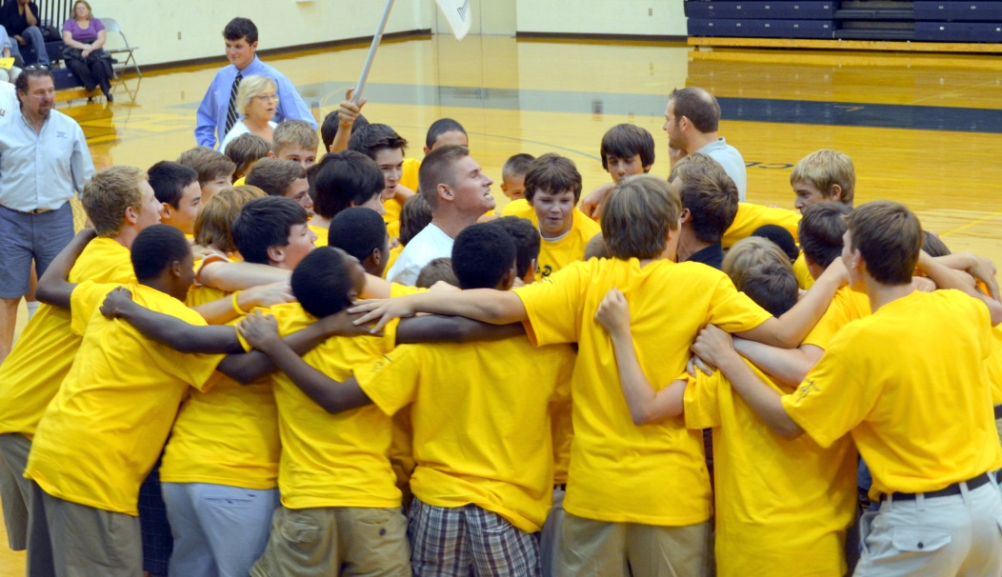
Bill & Debbie Geiger Family Scholarship
This scholarship will be awarded to a student with demonstrated
financial need. The award will be renewable
each year if the student remains on the Honor Roll and
participates in at least two co-curricular activities. This
Man of Moeller will also display Christian leadership at
Moeller and within the community. ($1,000)
Notes:
Annual Fund Budget Goal: $1M. Measurable Objectives: Five appointments per week; AF One Call Thank You(s); AF Committee Strategic Plan; Faculty-Staff Assistance; Parent Pride; AF Brochure; AF email reminders; President’s Dinner; AF Envelope in Magazines; AF Christmas Card; AF Letters/Postcards. Athletic Fundraising Budget Goal $100K. Measurable Objective: Plan and Execute Athletic Development Strategic Plan.

Slide 9
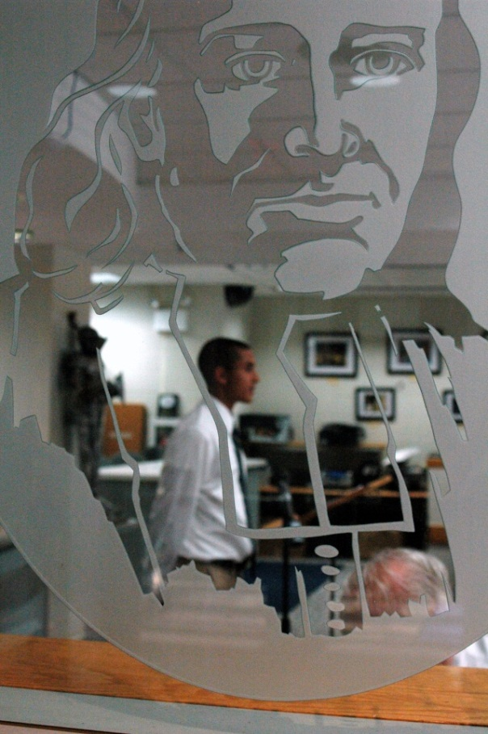
Grau Family Scholarship
This scholarship will be awarded to a young man who exemplifies the true character of a “Man of Moeller,” demonstrates leadership among his classmates, and provides
service to his community, and whose family demonstrates financial need. ($2,800)
Notes:
Annual Fund Budget Goal: $1M. Measurable Objectives: Five appointments per week; AF One Call Thank You(s); AF Committee Strategic Plan; Faculty-Staff Assistance; Parent Pride; AF Brochure; AF email reminders; President’s Dinner; AF Envelope in Magazines; AF Christmas Card; AF Letters/Postcards. Athletic Fundraising Budget Goal $100K. Measurable Objective: Plan and Execute Athletic Development Strategic Plan.

Slide 10
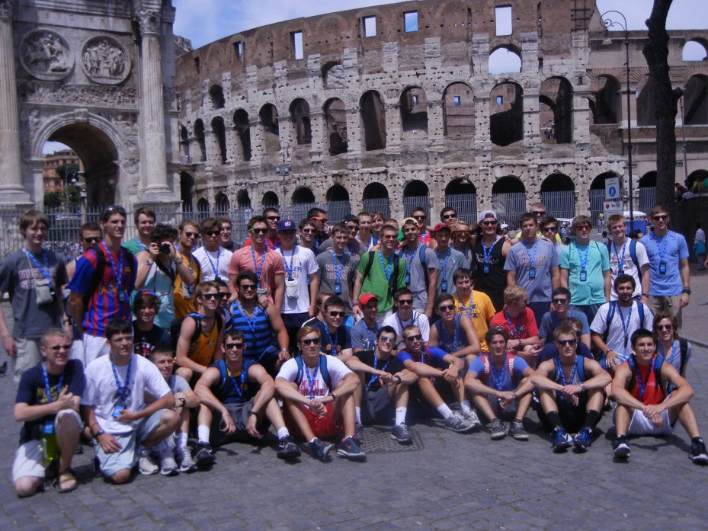
Walt & Jeanne Guller Scholarship
This scholarship will be awarded to a student with demonstrated
financial need. The award will be renewed each
year if the student remains on the Honor Roll, participates
in at least one co-curricular activity, and continues to
demonstrate financial need. (one-quarter tuition scholarship)
Notes:
Annual Fund Budget Goal: $1M. Measurable Objectives: Five appointments per week; AF One Call Thank You(s); AF Committee Strategic Plan; Faculty-Staff Assistance; Parent Pride; AF Brochure; AF email reminders; President’s Dinner; AF Envelope in Magazines; AF Christmas Card; AF Letters/Postcards. Athletic Fundraising Budget Goal $100K. Measurable Objective: Plan and Execute Athletic Development Strategic Plan.

Slide 11
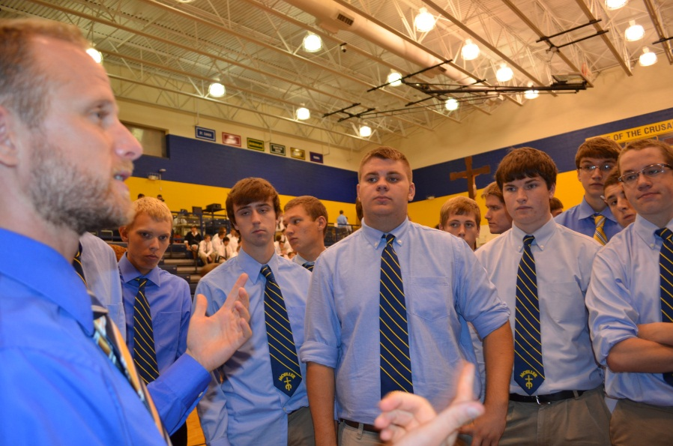
Tom & Charlotte Kilcoyne Scholarship
This scholarship will be awarded to a student with demonstrated
financial need. The award will be renewed each
year if the student remains on the Honor Roll, participates
in at least one co-curricular activity, and continues to
demonstrate financial need. (one-quarter tuition scholarship)
Notes:
Annual Fund Budget Goal: $1M. Measurable Objectives: Five appointments per week; AF One Call Thank You(s); AF Committee Strategic Plan; Faculty-Staff Assistance; Parent Pride; AF Brochure; AF email reminders; President’s Dinner; AF Envelope in Magazines; AF Christmas Card; AF Letters/Postcards. Athletic Fundraising Budget Goal $100K. Measurable Objective: Plan and Execute Athletic Development Strategic Plan.

Slide 12
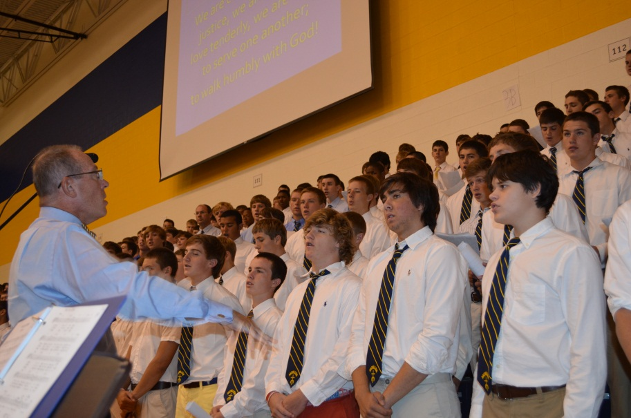
Dr. Edward Kremchek Scholarships
(5 awards)
These scholarships will be awarded to returning students
with demonstrated financial need. Recipients must participate
in at least two co-curricular activities or one cocurricular
activity and be employed outside of Moeller. Recipients must maintain at least Second Honors. ($2,000 each)
Notes:
Annual Fund Budget Goal: $1M. Measurable Objectives: Five appointments per week; AF One Call Thank You(s); AF Committee Strategic Plan; Faculty-Staff Assistance; Parent Pride; AF Brochure; AF email reminders; President’s Dinner; AF Envelope in Magazines; AF Christmas Card; AF Letters/Postcards. Athletic Fundraising Budget Goal $100K. Measurable Objective: Plan and Execute Athletic Development Strategic Plan.

Slide 13
Loewenstine Family Scholarship
This scholarship will be awarded to a Moeller student
who exemplifies the Marianist characteristics of excellence
in academics, leadership, community service, and
demonstrates financial need. This scholarship is renewable
as long as the student continues to demonstrate
financial need and remains 100% committed to becoming
a “Man of Moeller” through determination, drive and
hard work and will serve as an example to other Moeller
students. ($1,000)
Notes:
Annual Fund Budget Goal: $1M. Measurable Objectives: Five appointments per week; AF One Call Thank You(s); AF Committee Strategic Plan; Faculty-Staff Assistance; Parent Pride; AF Brochure; AF email reminders; President’s Dinner; AF Envelope in Magazines; AF Christmas Card; AF Letters/Postcards. Athletic Fundraising Budget Goal $100K. Measurable Objective: Plan and Execute Athletic Development Strategic Plan.

Slide 14
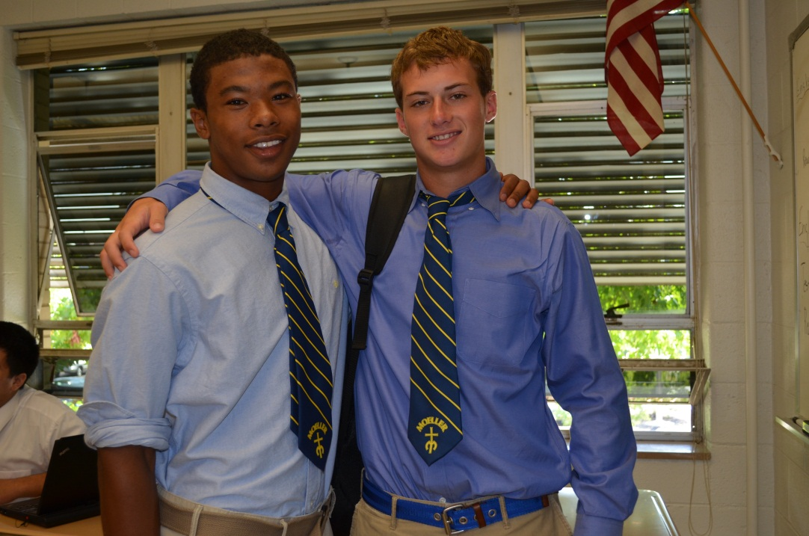
Rene’ ‘69 and Roland Molina Memorial
Scholarship
This scholarship will be given to a student with a GPA of
3.0 or higher with demonstrated financial need. First consideration
will go to students who are of Hispanic descent.
($500)
Notes:
Annual Fund Budget Goal: $1M. Measurable Objectives: Five appointments per week; AF One Call Thank You(s); AF Committee Strategic Plan; Faculty-Staff Assistance; Parent Pride; AF Brochure; AF email reminders; President’s Dinner; AF Envelope in Magazines; AF Christmas Card; AF Letters/Postcards. Athletic Fundraising Budget Goal $100K. Measurable Objective: Plan and Execute Athletic Development Strategic Plan.

Slide 15
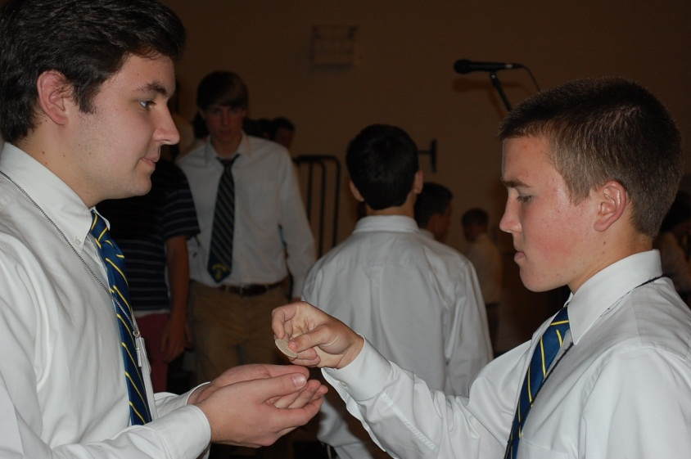
Bob & Arlene Niehaus Family Scholarship
This scholarship will be awarded to a student who demonstrates
leadership in academics, service to the Moeller
community, and has demonstrated financial need. The
scholarship is renewable as long as the student has demonstrated
financial need and remains committed to the
above criteria. ($1,000)
Notes:
Annual Fund Budget Goal: $1M. Measurable Objectives: Five appointments per week; AF One Call Thank You(s); AF Committee Strategic Plan; Faculty-Staff Assistance; Parent Pride; AF Brochure; AF email reminders; President’s Dinner; AF Envelope in Magazines; AF Christmas Card; AF Letters/Postcards. Athletic Fundraising Budget Goal $100K. Measurable Objective: Plan and Execute Athletic Development Strategic Plan.

Slide 16
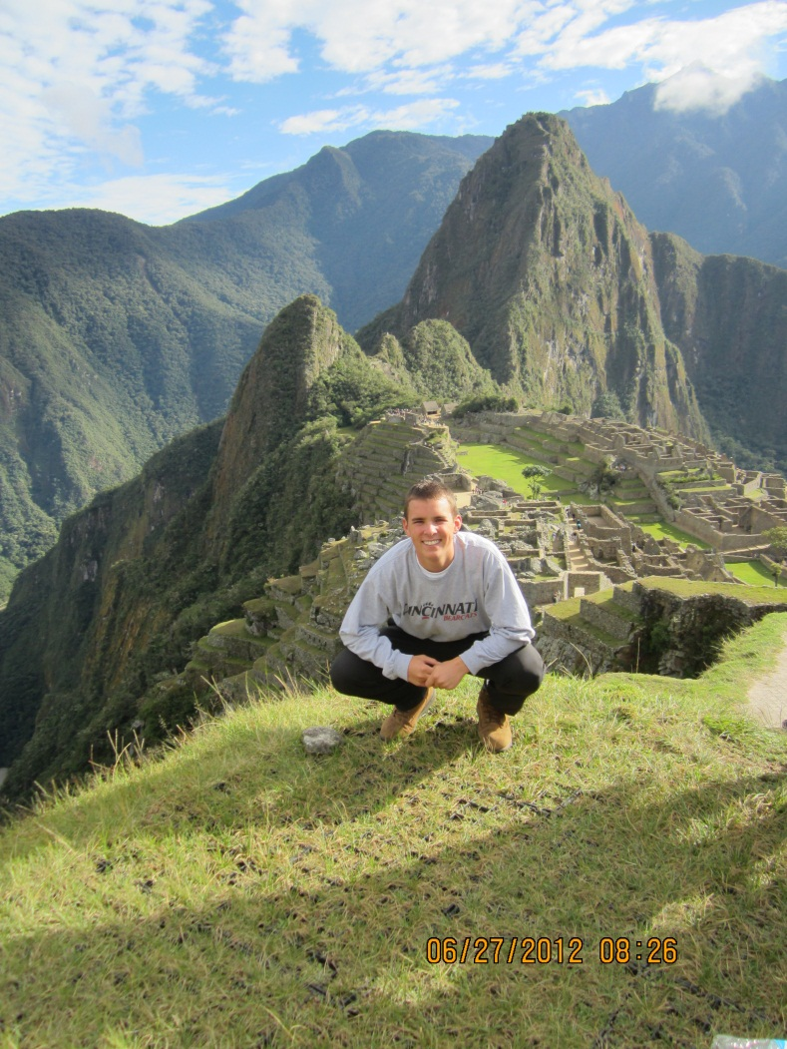
Class of 2011 Josh Pflum Scholarship
This scholarship will be awarded in memory of Josh Pflum who was a member of the Class of 2011. The student must have demonstrated financial need. ($1,000)
Notes:
Annual Fund Budget Goal: $1M. Measurable Objectives: Five appointments per week; AF One Call Thank You(s); AF Committee Strategic Plan; Faculty-Staff Assistance; Parent Pride; AF Brochure; AF email reminders; President’s Dinner; AF Envelope in Magazines; AF Christmas Card; AF Letters/Postcards. Athletic Fundraising Budget Goal $100K. Measurable Objective: Plan and Execute Athletic Development Strategic Plan.

Slide 17
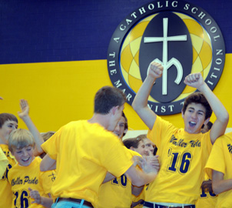
Rains Family Scholarship
This scholarship will be awarded to a student who participates
in at least one co-curricular activity, who is committed
to community service and pastoral ministries, and has
demonstrates financial need. This scholarship is renewable
if the criterion is met. ($1,000)
Notes:
Annual Fund Budget Goal: $1M. Measurable Objectives: Five appointments per week; AF One Call Thank You(s); AF Committee Strategic Plan; Faculty-Staff Assistance; Parent Pride; AF Brochure; AF email reminders; President’s Dinner; AF Envelope in Magazines; AF Christmas Card; AF Letters/Postcards. Athletic Fundraising Budget Goal $100K. Measurable Objective: Plan and Execute Athletic Development Strategic Plan.

Slide 18
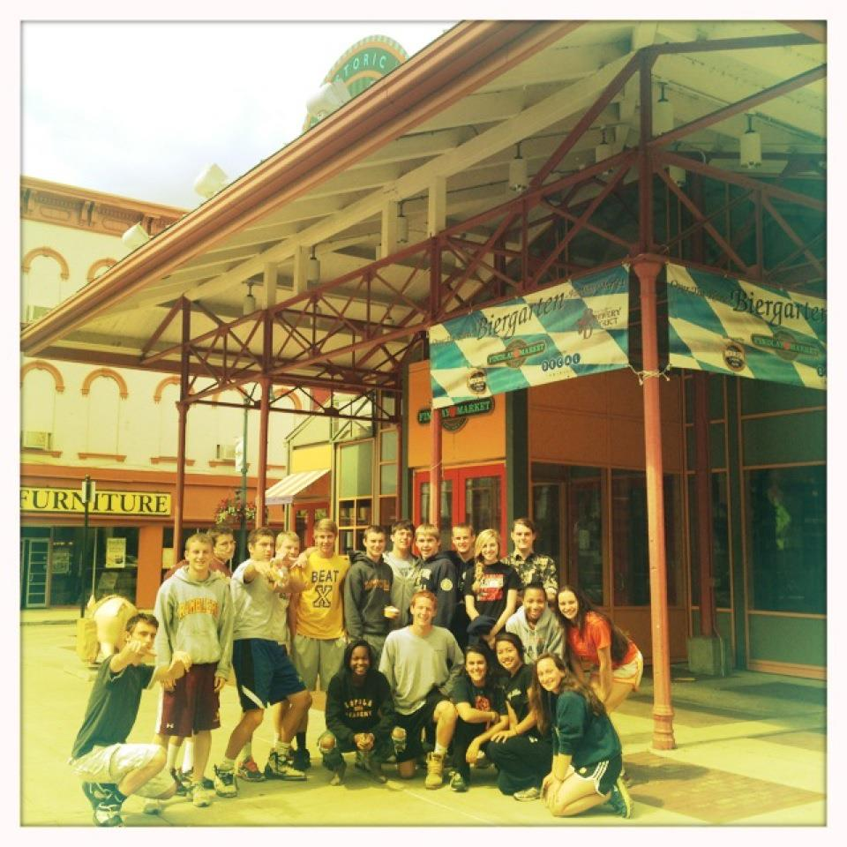
Schira Family Scholarship
This scholarship will be awarded to a student who is involved in Moeller High School co-curricular activities,
demonstrates outstanding effort in academics, exemplifies Christian values, and demonstrates financial need. ($2,800)
Notes:
Annual Fund Budget Goal: $1M. Measurable Objectives: Five appointments per week; AF One Call Thank You(s); AF Committee Strategic Plan; Faculty-Staff Assistance; Parent Pride; AF Brochure; AF email reminders; President’s Dinner; AF Envelope in Magazines; AF Christmas Card; AF Letters/Postcards. Athletic Fundraising Budget Goal $100K. Measurable Objective: Plan and Execute Athletic Development Strategic Plan.

Slide 19
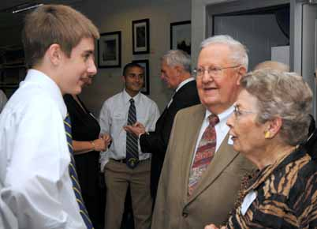
Eric J. Schlueter ‘68 Scholarship
The scholarship will be awarded to an incoming freshman
with demonstrated financial need. This award will be renewed
each year if the student maintains Honor-Roll status
and participates in at least one co-curricular activity
per year. ($2,500)
Notes:
Annual Fund Budget Goal: $1M. Measurable Objectives: Five appointments per week; AF One Call Thank You(s); AF Committee Strategic Plan; Faculty-Staff Assistance; Parent Pride; AF Brochure; AF email reminders; President’s Dinner; AF Envelope in Magazines; AF Christmas Card; AF Letters/Postcards. Athletic Fundraising Budget Goal $100K. Measurable Objective: Plan and Execute Athletic Development Strategic Plan.

Slide 20
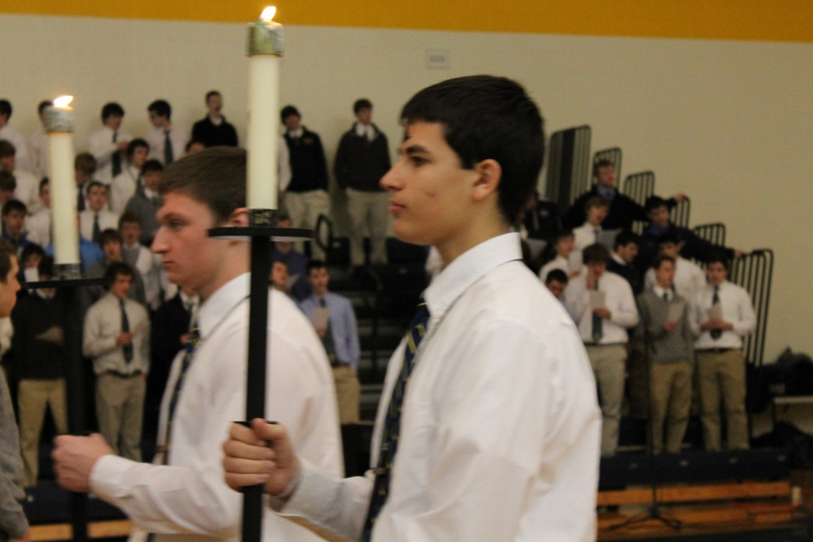
Schmitt/Judd Family Scholarship
This scholarship will be awarded to a deserving student with demonstrated financial need. (Award determined by current interest rate of endowment, approximately $900)
Notes:
Annual Fund Budget Goal: $1M. Measurable Objectives: Five appointments per week; AF One Call Thank You(s); AF Committee Strategic Plan; Faculty-Staff Assistance; Parent Pride; AF Brochure; AF email reminders; President’s Dinner; AF Envelope in Magazines; AF Christmas Card; AF Letters/Postcards. Athletic Fundraising Budget Goal $100K. Measurable Objective: Plan and Execute Athletic Development Strategic Plan.

Slide 21
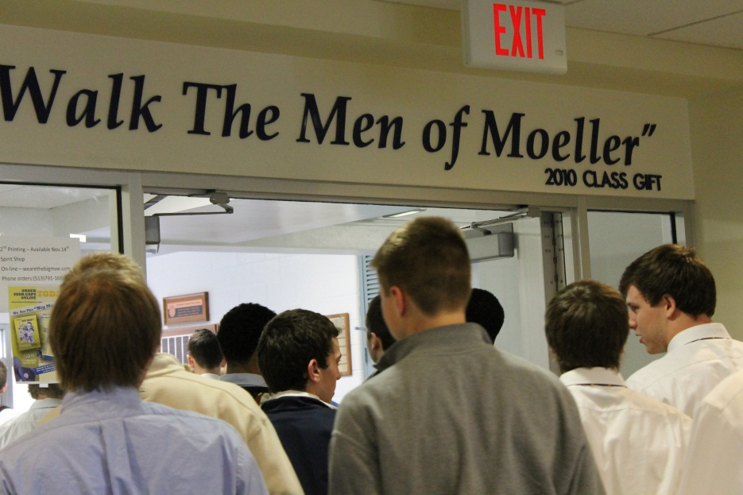
Michael A. Stofko Memorial Scholarship
The scholarship will be awarded to a student who is involved
in Moeller co-curricular activities, demonstrates
outstanding effort in academics, exemplifies Christian
values, and demonstrates financial need. ($2,300)
Notes:
Annual Fund Budget Goal: $1M. Measurable Objectives: Five appointments per week; AF One Call Thank You(s); AF Committee Strategic Plan; Faculty-Staff Assistance; Parent Pride; AF Brochure; AF email reminders; President’s Dinner; AF Envelope in Magazines; AF Christmas Card; AF Letters/Postcards. Athletic Fundraising Budget Goal $100K. Measurable Objective: Plan and Execute Athletic Development Strategic Plan.

Slide 22
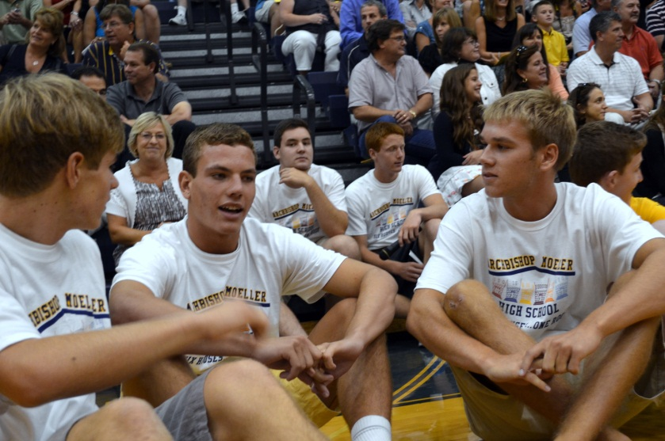
Suter Family Scholarship
This scholarship will be awarded to a student who is involved
in at least one Moeller co-curricular activity, exhibits
outstanding effort in academics, exemplifies Christian
values, and demonstrates financial need. The scholarship
is renewable as long as the student continues to meet the
scholarship criteria. (half - tuition scholarship)
Notes:
Annual Fund Budget Goal: $1M. Measurable Objectives: Five appointments per week; AF One Call Thank You(s); AF Committee Strategic Plan; Faculty-Staff Assistance; Parent Pride; AF Brochure; AF email reminders; President’s Dinner; AF Envelope in Magazines; AF Christmas Card; AF Letters/Postcards. Athletic Fundraising Budget Goal $100K. Measurable Objective: Plan and Execute Athletic Development Strategic Plan.

Slide 23
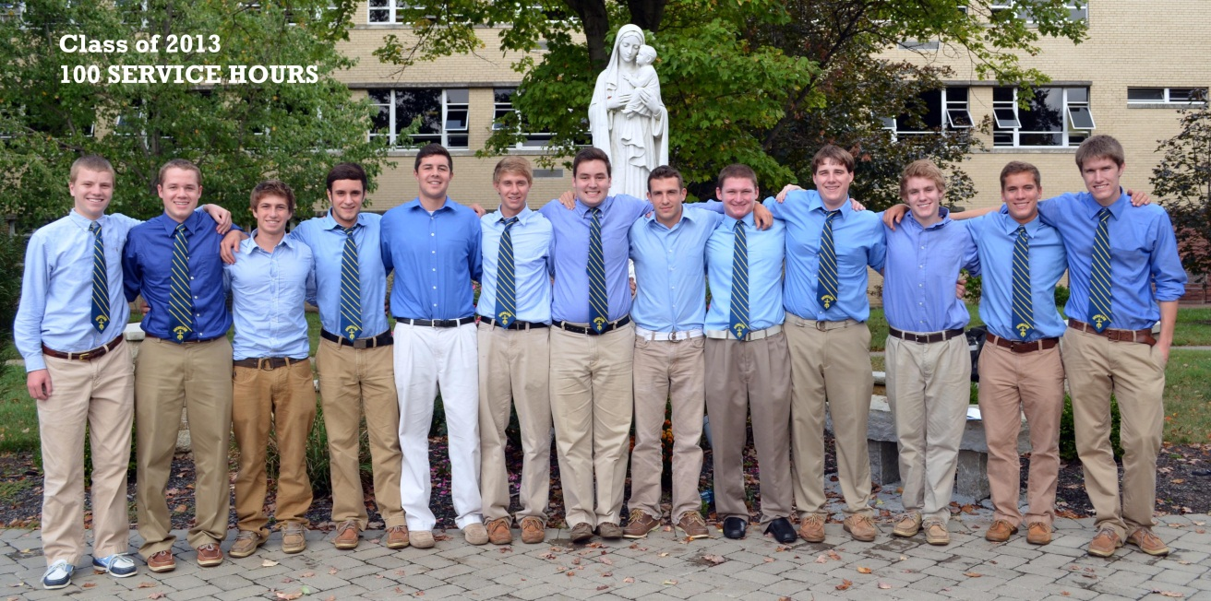
Michael Cleveland Sylvester Memorial
Scholarship
This scholarship is awarded to a student who participates
in a co-curricular activity and has demonstrated financial
need. (Award up to $5,000)
Notes:
Annual Fund Budget Goal: $1M. Measurable Objectives: Five appointments per week; AF One Call Thank You(s); AF Committee Strategic Plan; Faculty-Staff Assistance; Parent Pride; AF Brochure; AF email reminders; President’s Dinner; AF Envelope in Magazines; AF Christmas Card; AF Letters/Postcards. Athletic Fundraising Budget Goal $100K. Measurable Objective: Plan and Execute Athletic Development Strategic Plan.

Slide 24
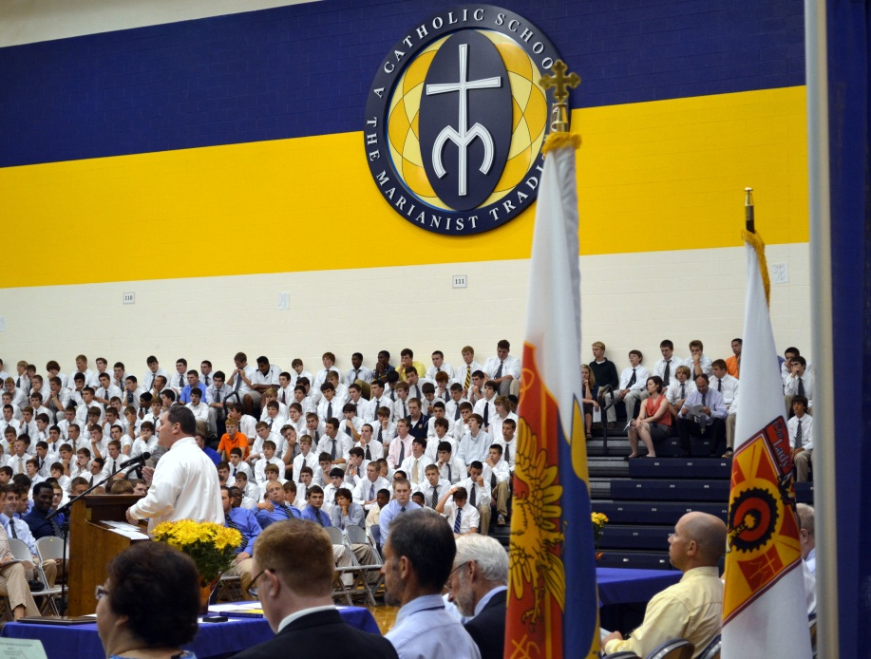
Michael J. Thorne ‘99 Scholarship
This scholarship is awarded to an individual whose family
has three or more children in Catholic schools, participates
in at least one co-curricular activity, maintains Honors, and whose family demonstrates financial need. This award is renewable as long as the scholarship criteria are met. ($500)
Notes:
Annual Fund Budget Goal: $1M. Measurable Objectives: Five appointments per week; AF One Call Thank You(s); AF Committee Strategic Plan; Faculty-Staff Assistance; Parent Pride; AF Brochure; AF email reminders; President’s Dinner; AF Envelope in Magazines; AF Christmas Card; AF Letters/Postcards. Athletic Fundraising Budget Goal $100K. Measurable Objective: Plan and Execute Athletic Development Strategic Plan.

Slide 25
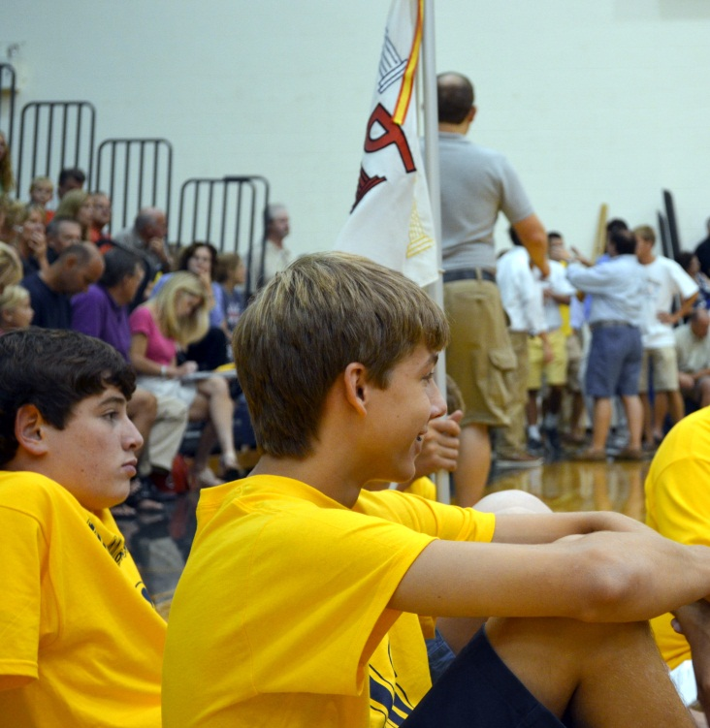
Dan and Nancy Hopkins Courage Scholarship
This scholarship will be awarded to a student with demonstrated
financial need and will benefit from a Moeller education in the same ways that the Hopkins’ brothers benefited from their education at Moeller.
Notes:
Annual Fund Budget Goal: $1M. Measurable Objectives: Five appointments per week; AF One Call Thank You(s); AF Committee Strategic Plan; Faculty-Staff Assistance; Parent Pride; AF Brochure; AF email reminders; President’s Dinner; AF Envelope in Magazines; AF Christmas Card; AF Letters/Postcards. Athletic Fundraising Budget Goal $100K. Measurable Objective: Plan and Execute Athletic Development Strategic Plan.

Slide 26
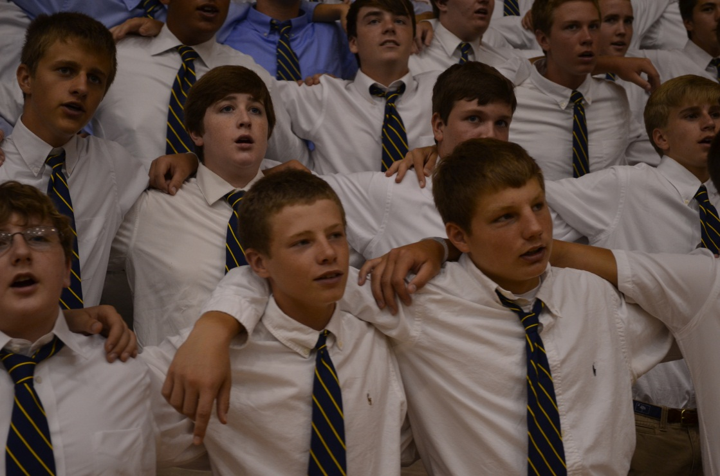
Michael Cleveland Sylvester Memorial
Scholarship
This scholarship is awarded to a student who participates
in a co-curricular activity and has demonstrated financial
need. (Award up to $5,000)
Notes:
Annual Fund Budget Goal: $1M. Measurable Objectives: Five appointments per week; AF One Call Thank You(s); AF Committee Strategic Plan; Faculty-Staff Assistance; Parent Pride; AF Brochure; AF email reminders; President’s Dinner; AF Envelope in Magazines; AF Christmas Card; AF Letters/Postcards. Athletic Fundraising Budget Goal $100K. Measurable Objective: Plan and Execute Athletic Development Strategic Plan.

Slide 27
From the students at Moeller High School…
Notes:
Development INVESTMENTS: Planned Giving: Measurable Objective – Plan and Execute 12-Month Marketing Plan (with Volunteer Jennifer Sturgis). Named Scholarships: Measurable Objective – Continue to grow named Scholarships Program by 25% or by at least $25K. Create a Named Scholarships Booklet and Host a Named Scholarship Breakfast.

Slide 28

Notes:
Timeline Exhibit Blessing & Mass on Sept. 11. Goal: To honor and recognize those who made this exhibit possible and to celebrate Moeller’s heritage and Marianist Charism. Founder’s Day on January 19, 2012. Goal: To Collaborate with Principal to successfully execute this celebration.

Slide 29
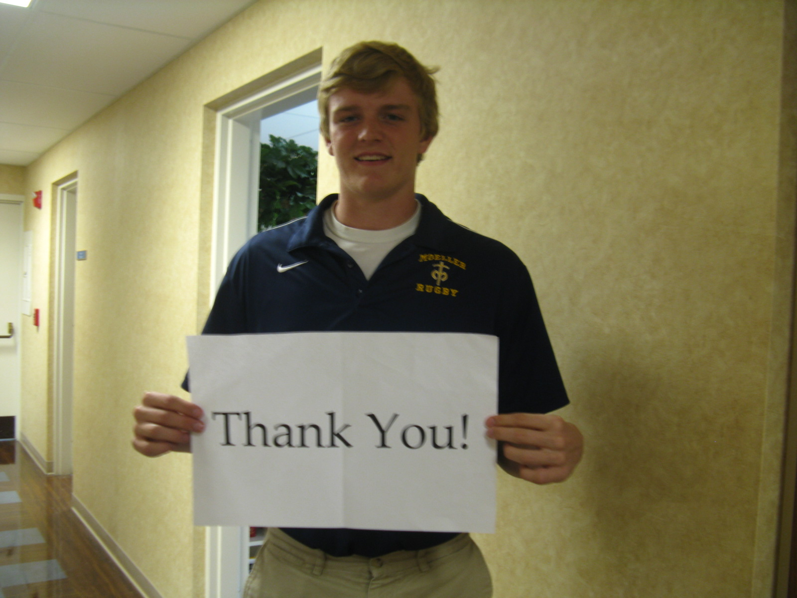

Slide 30


Slide 31
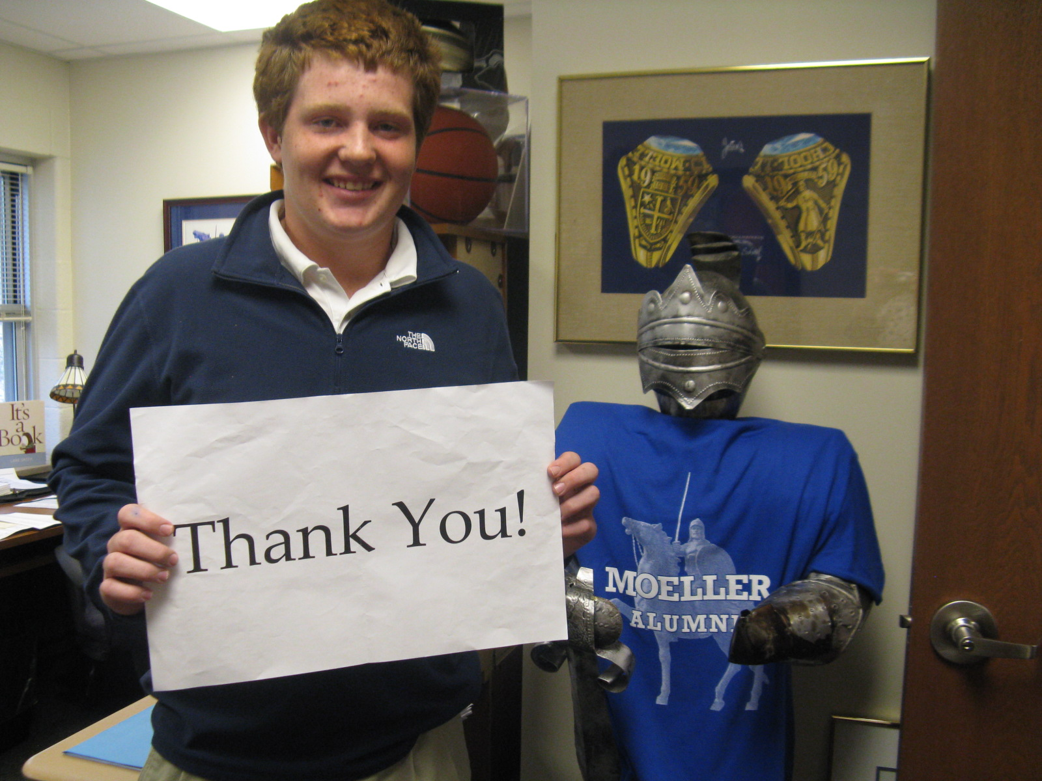

Slide 32
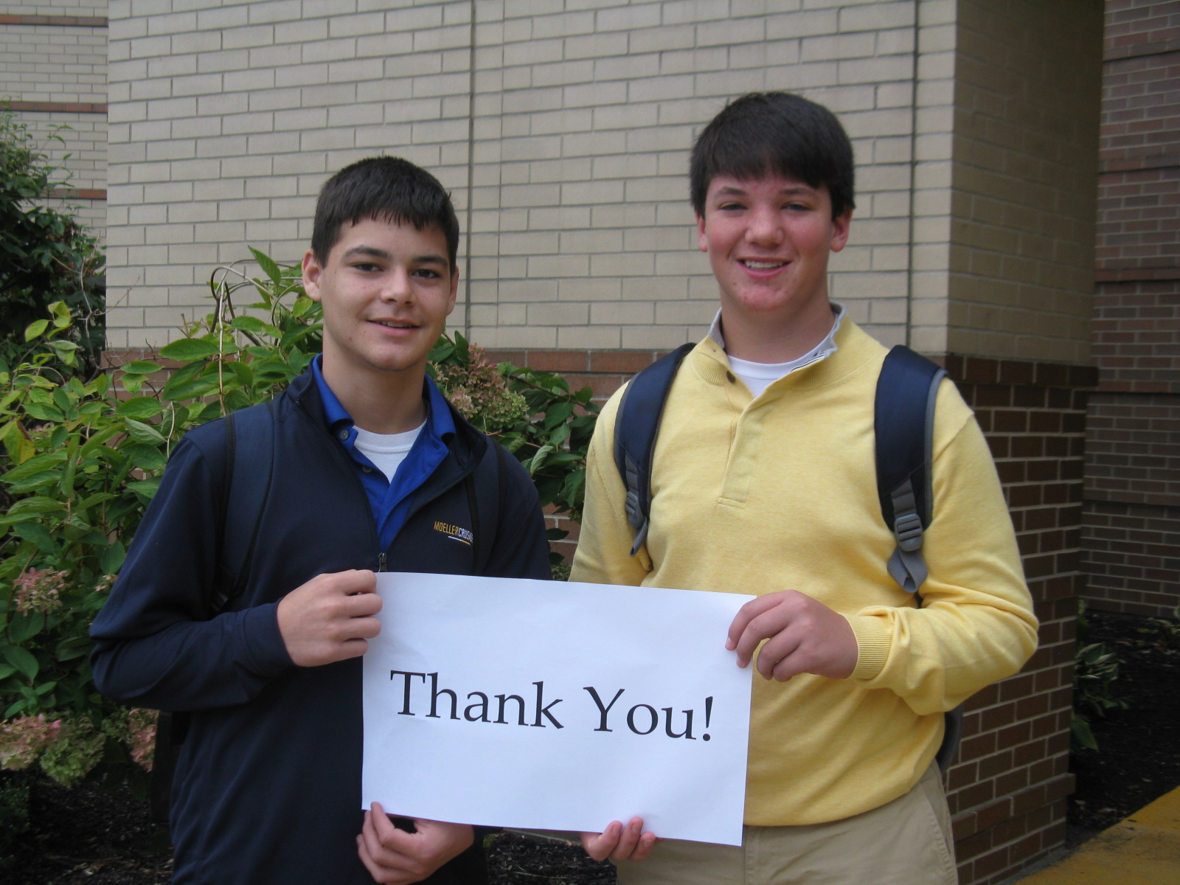

Slide 33
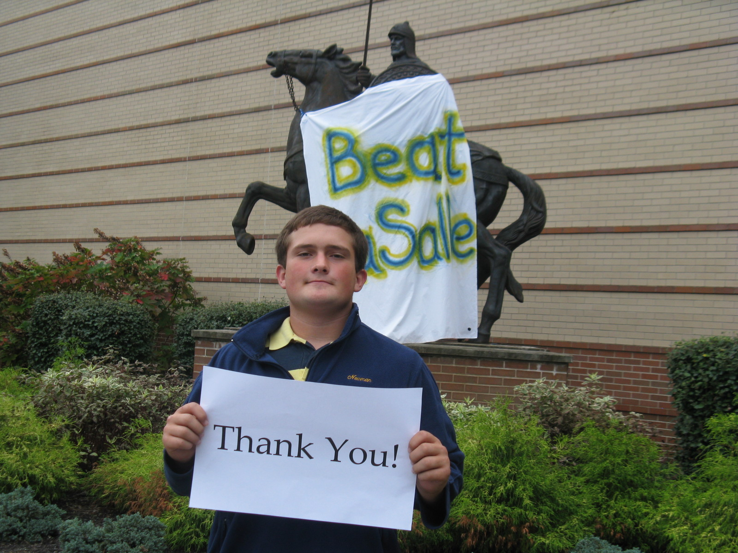

Slide 34


Slide 35
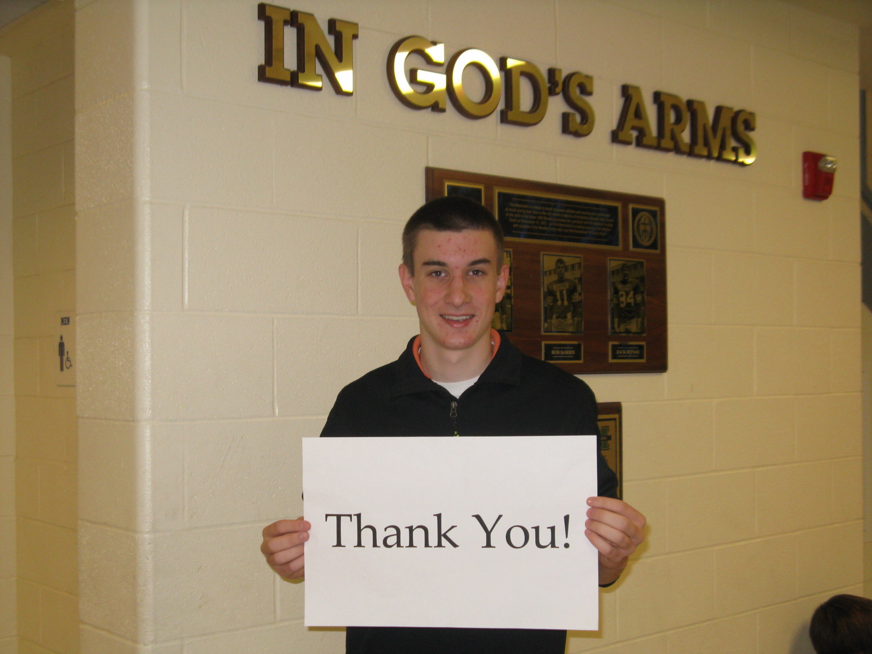

Slide 36
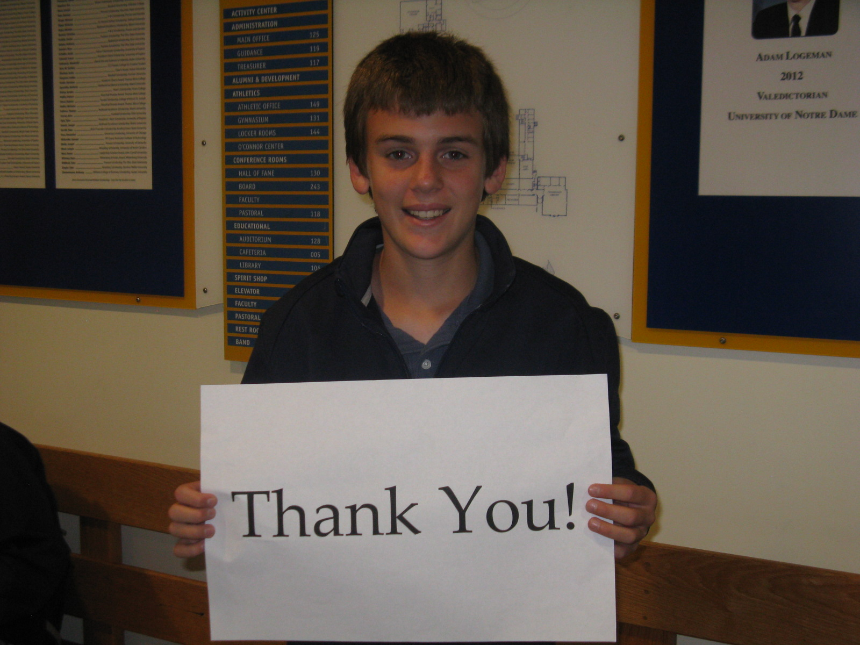

Slide 37
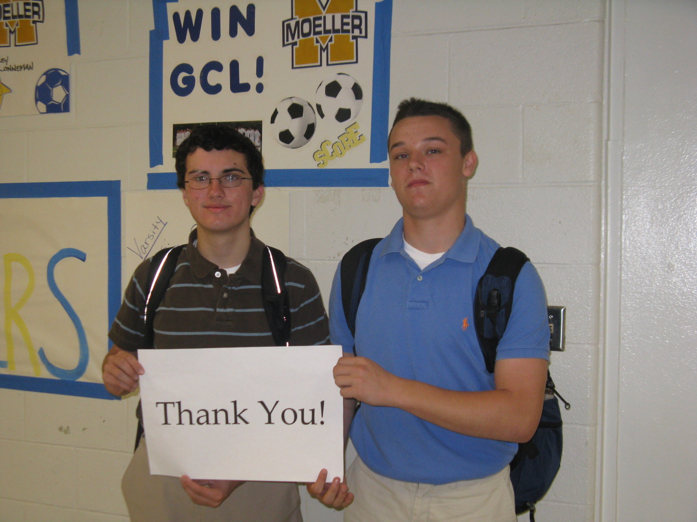

Slide 38
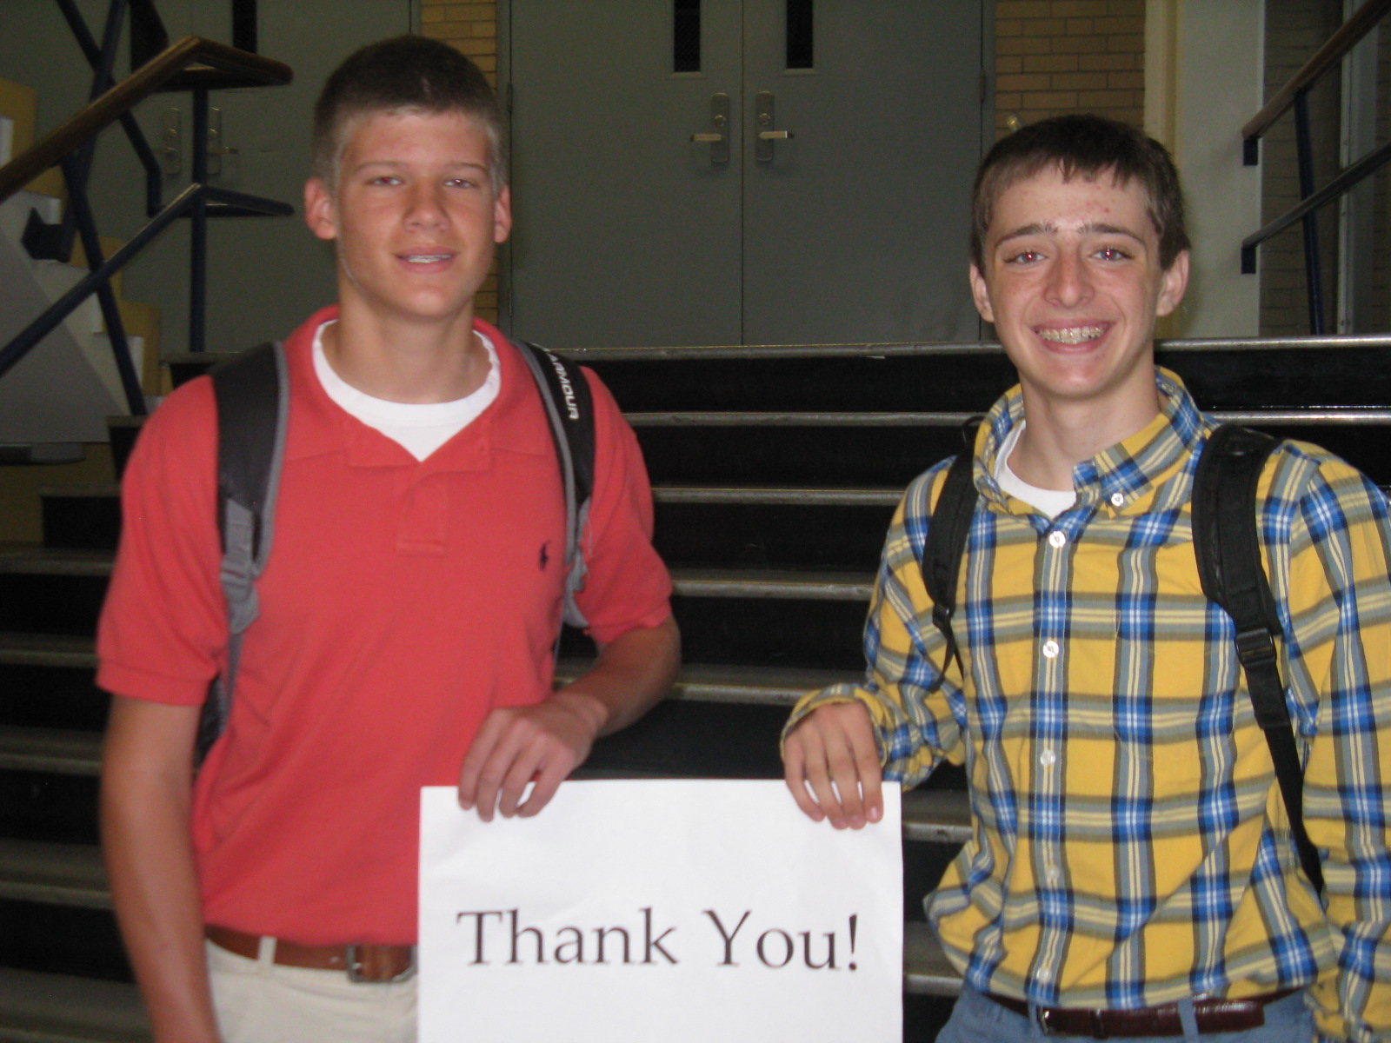

Slide 39
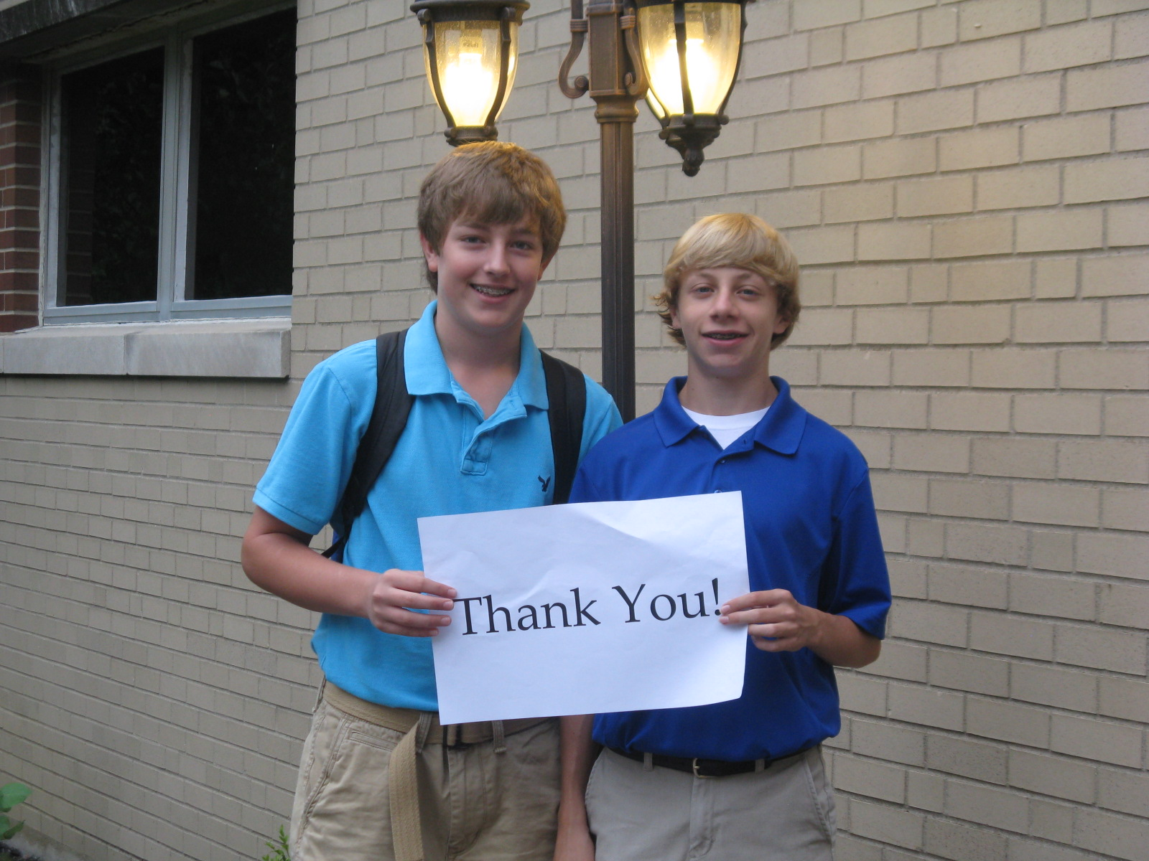

Slide 40
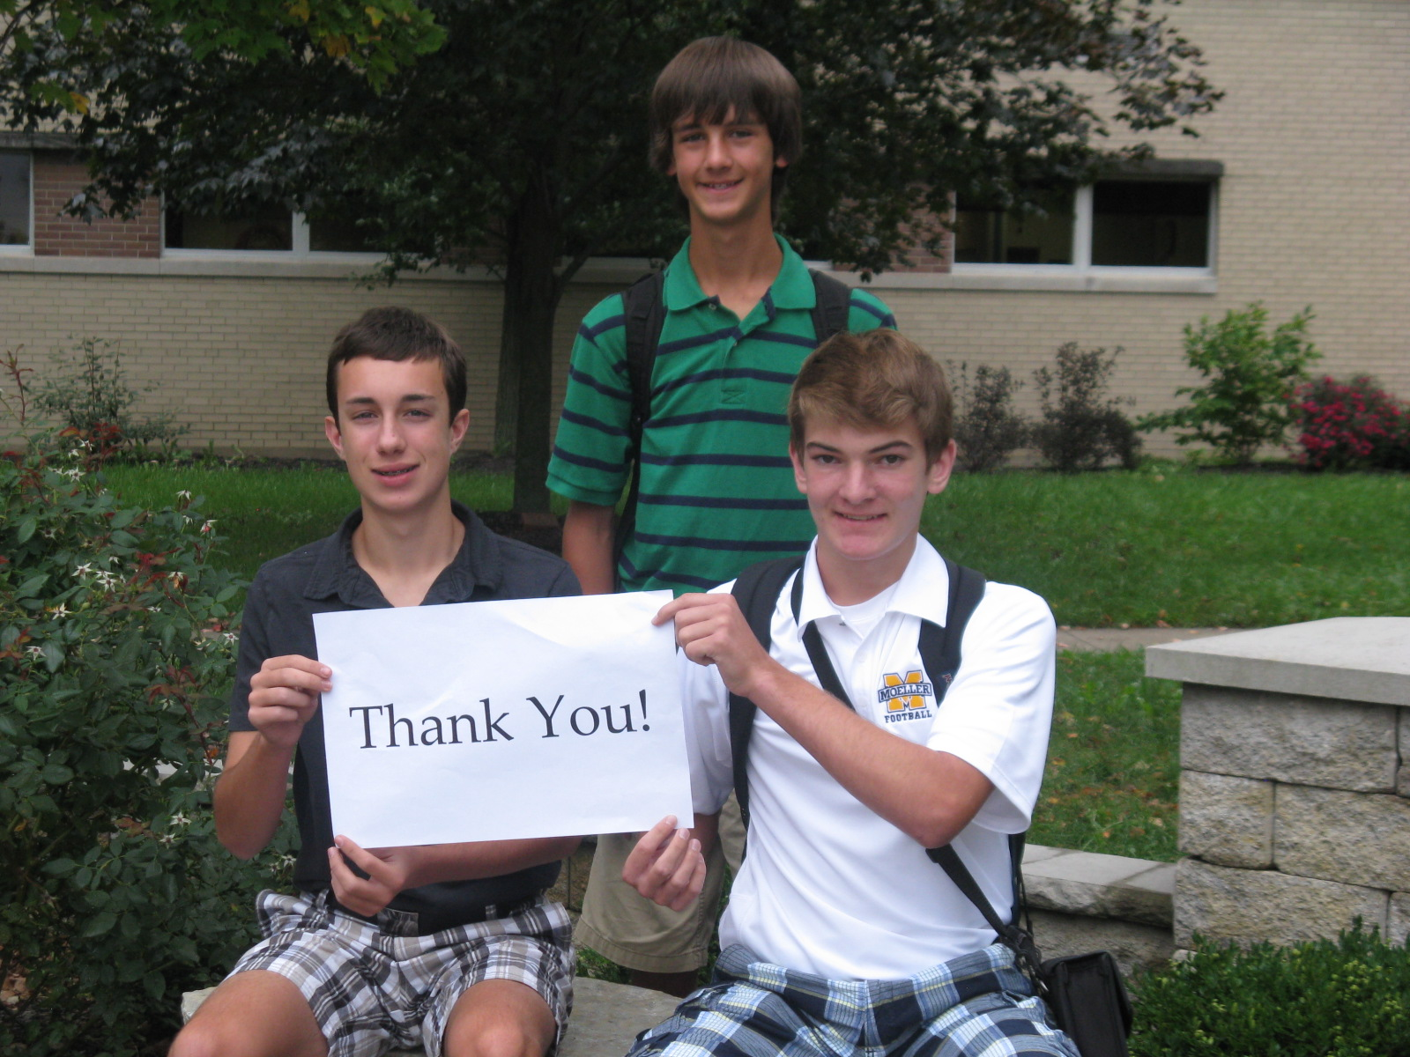

Slide 41
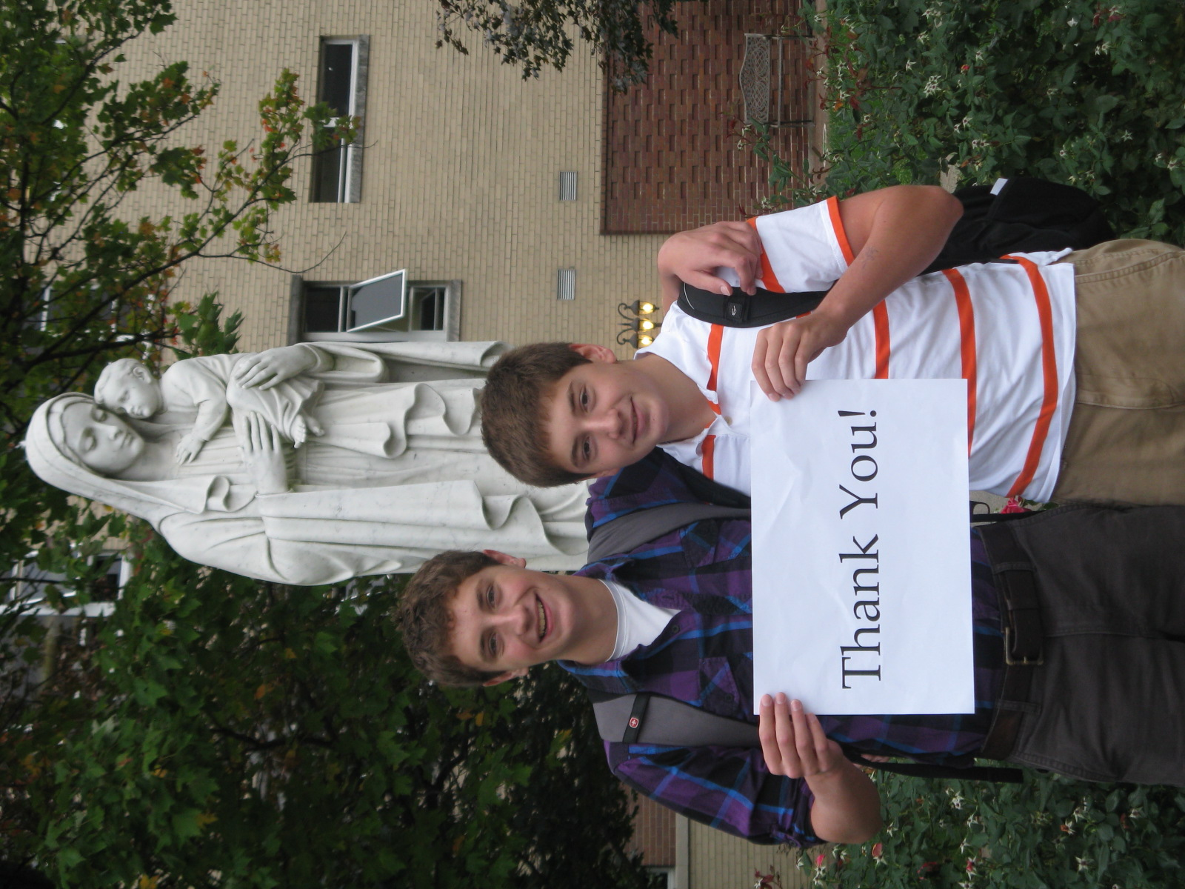

Slide 42
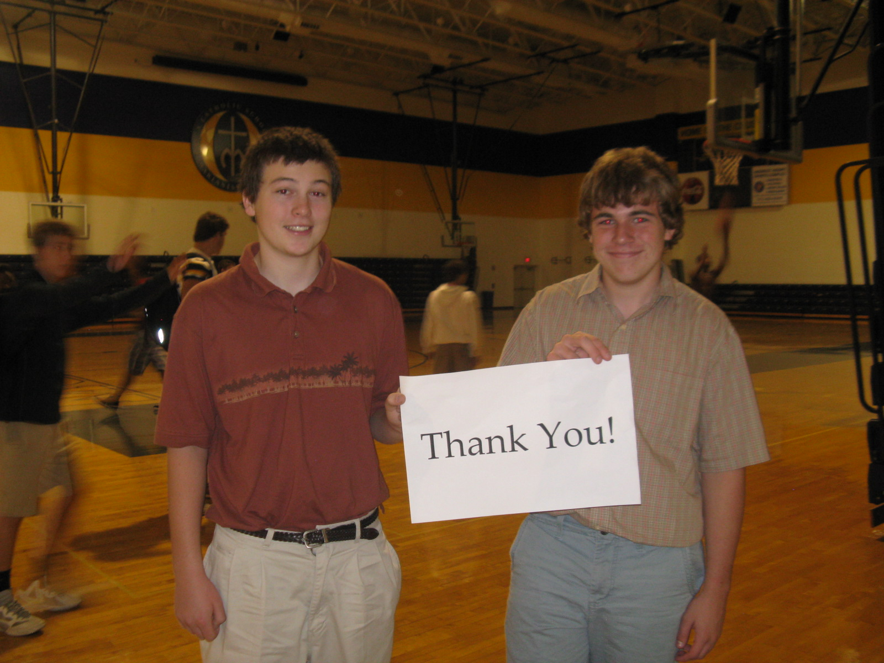

Slide 43


Slide 44
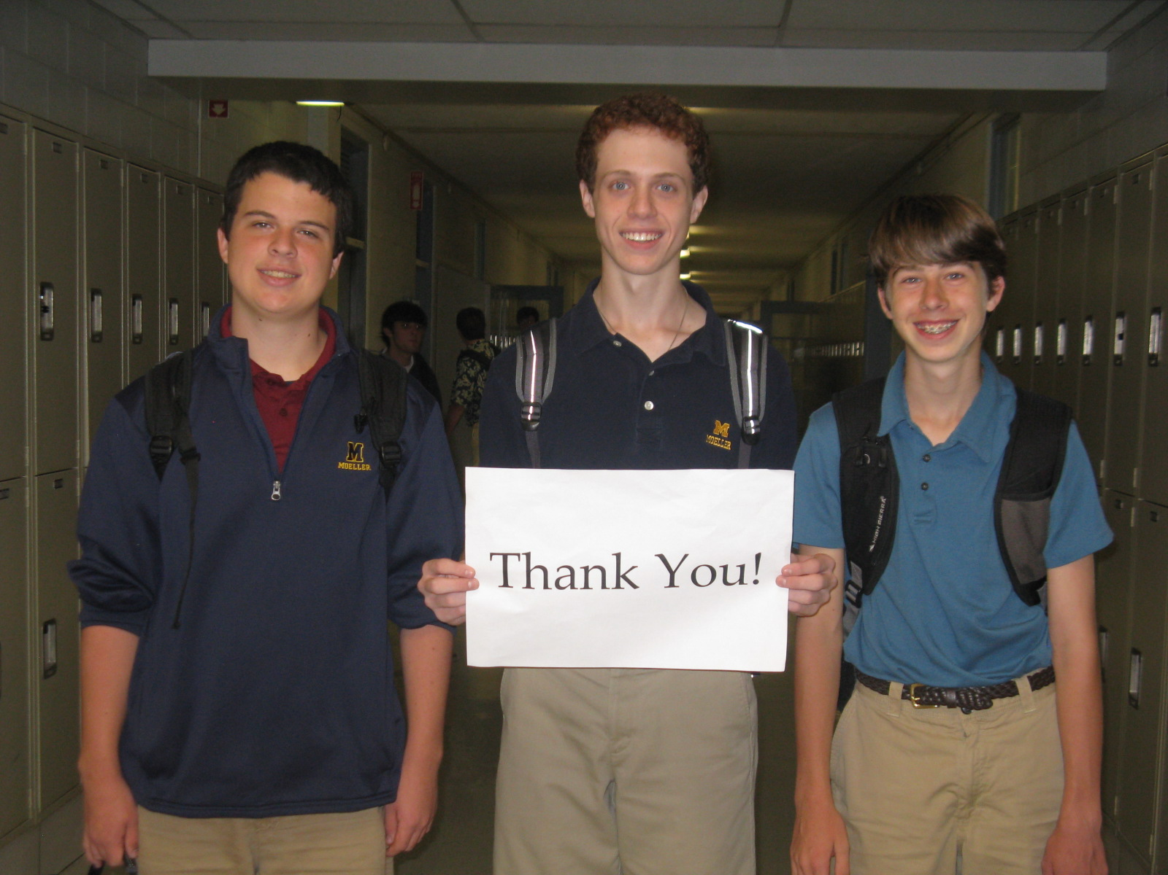

Slide 45
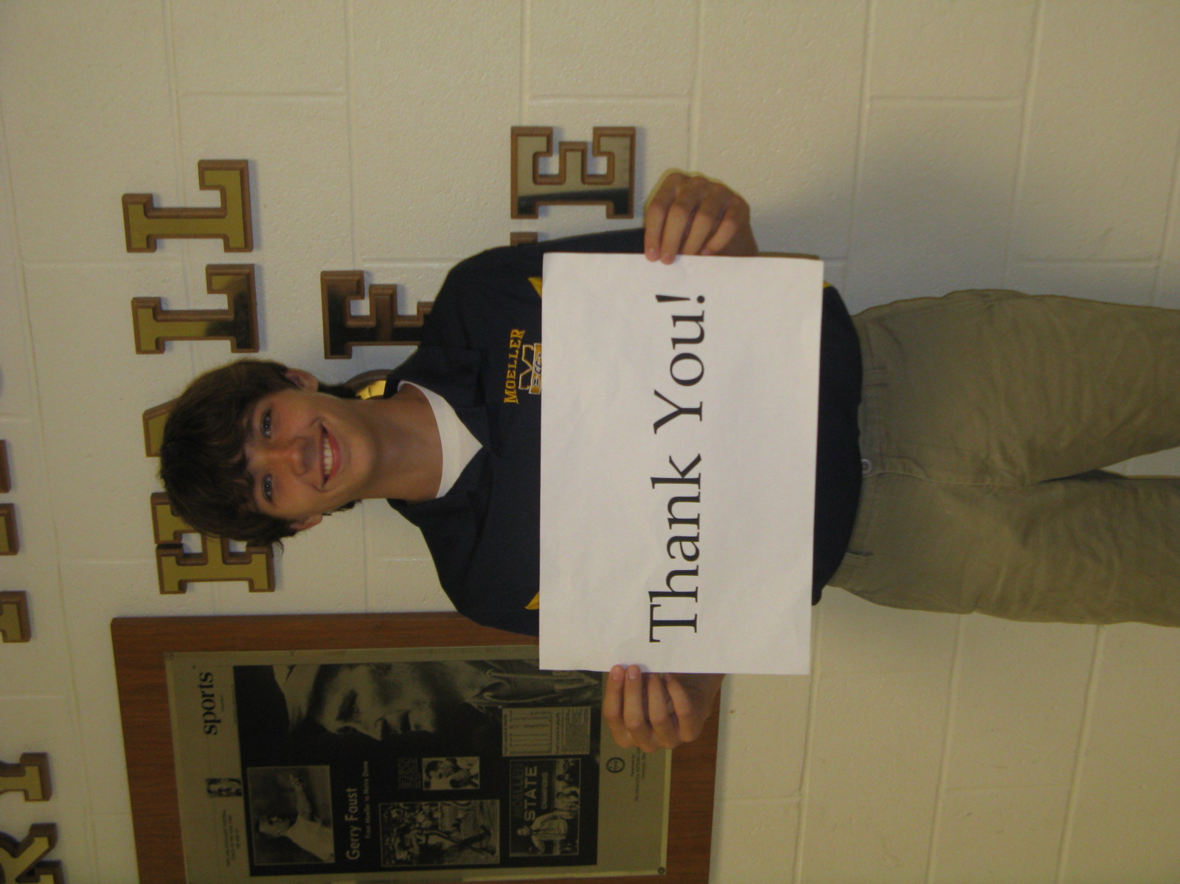

Slide 46
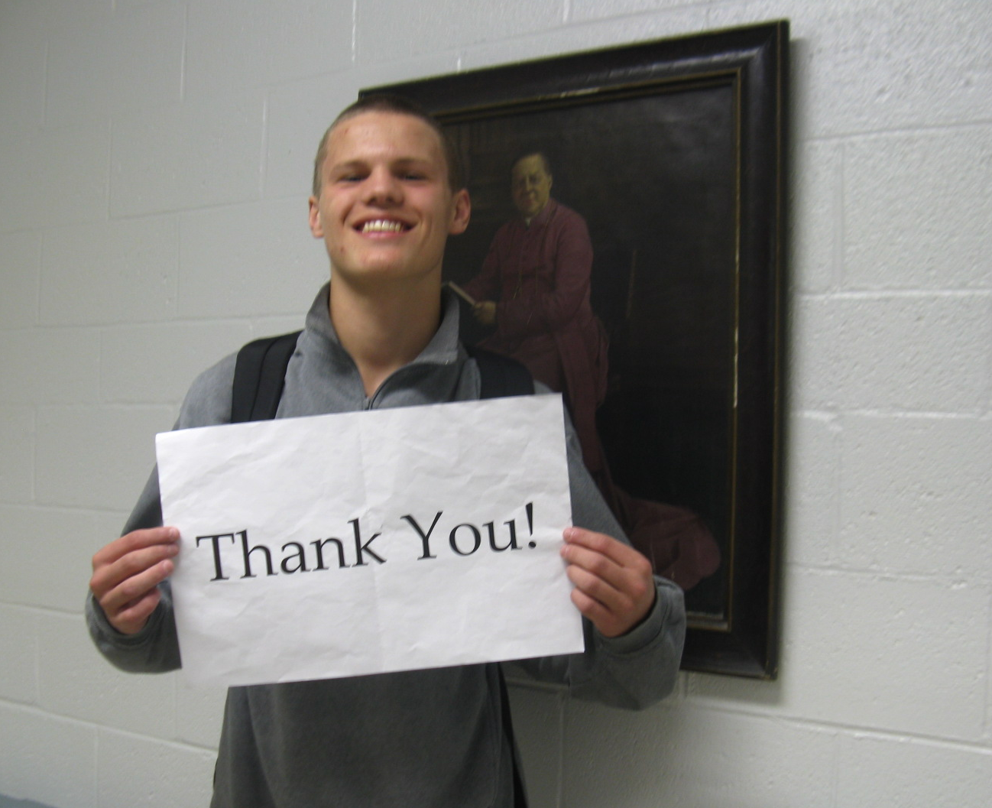

Slide 47
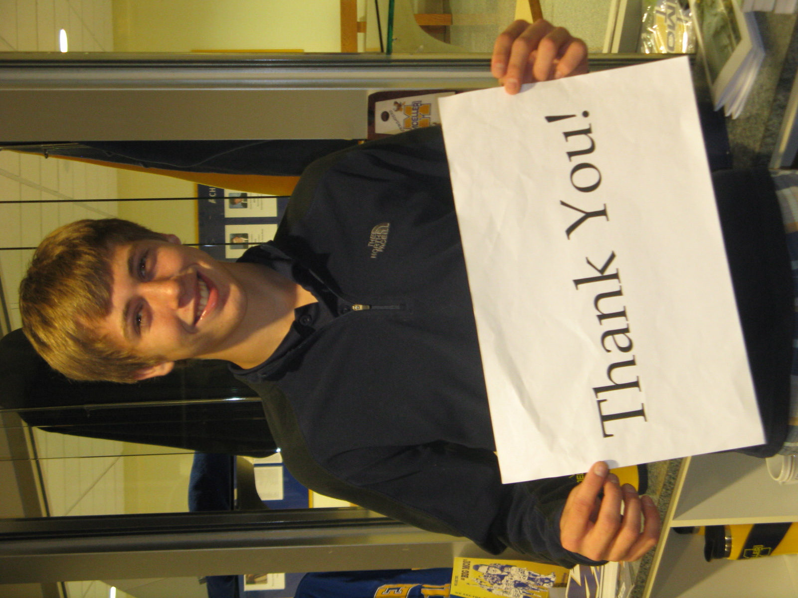

Slide 48


Slide 49
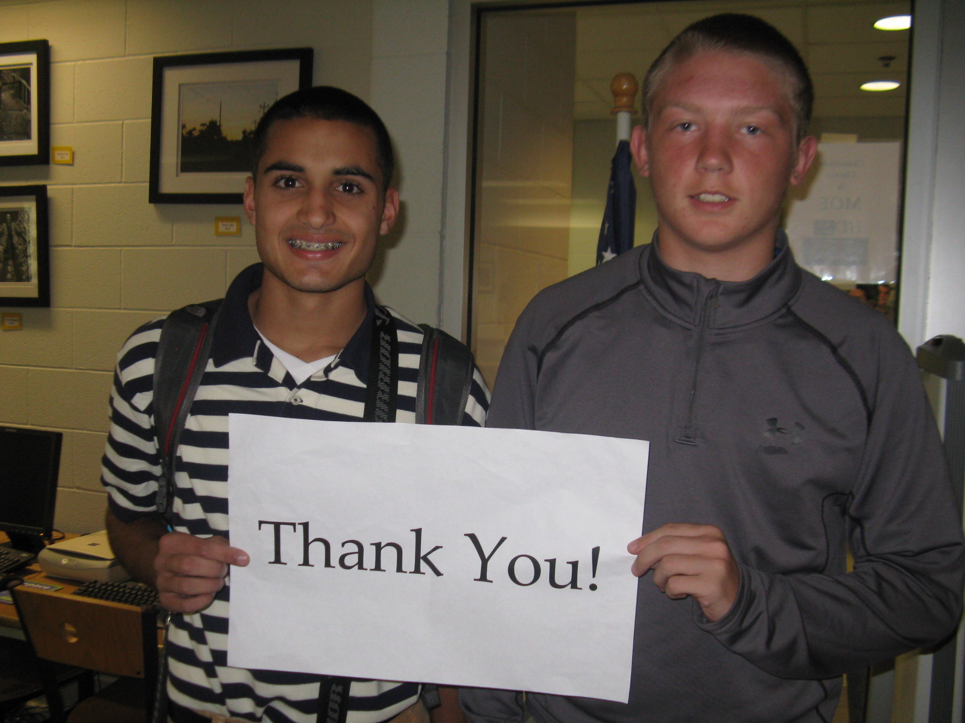

Slide 50
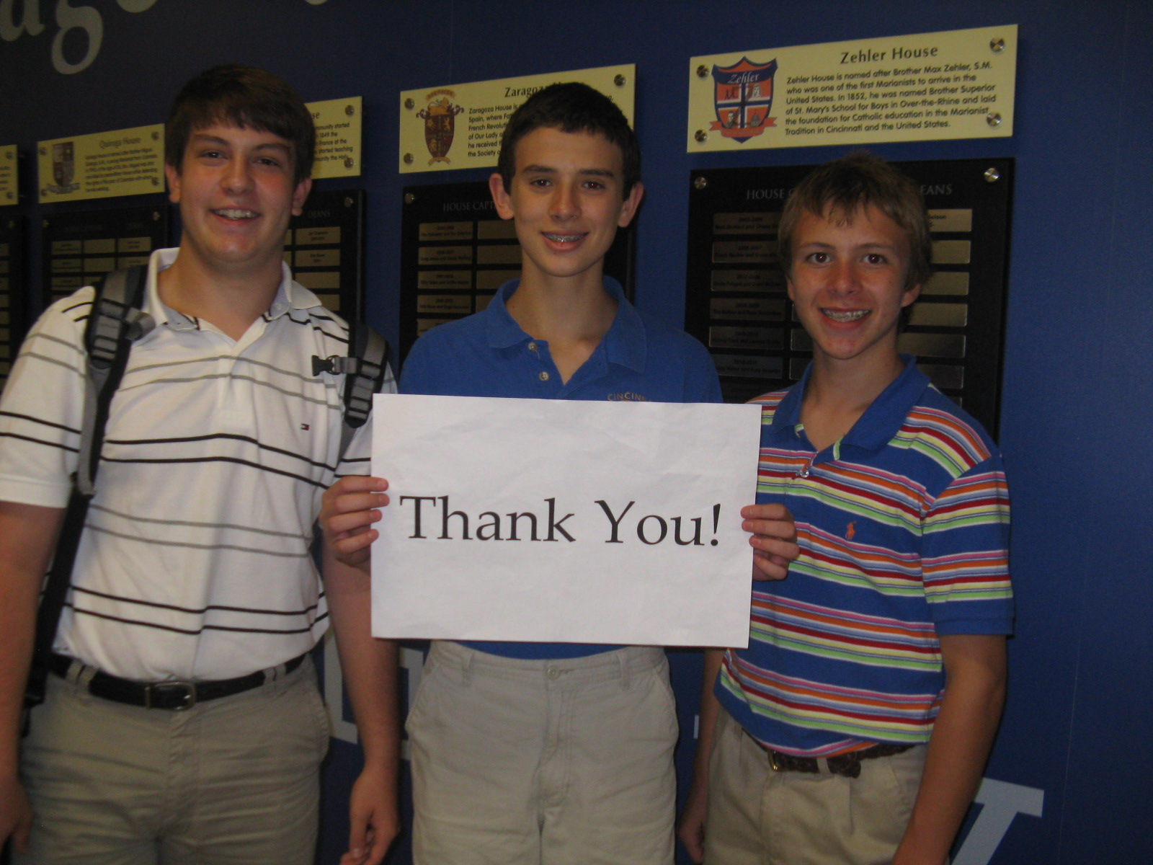

Slide 51
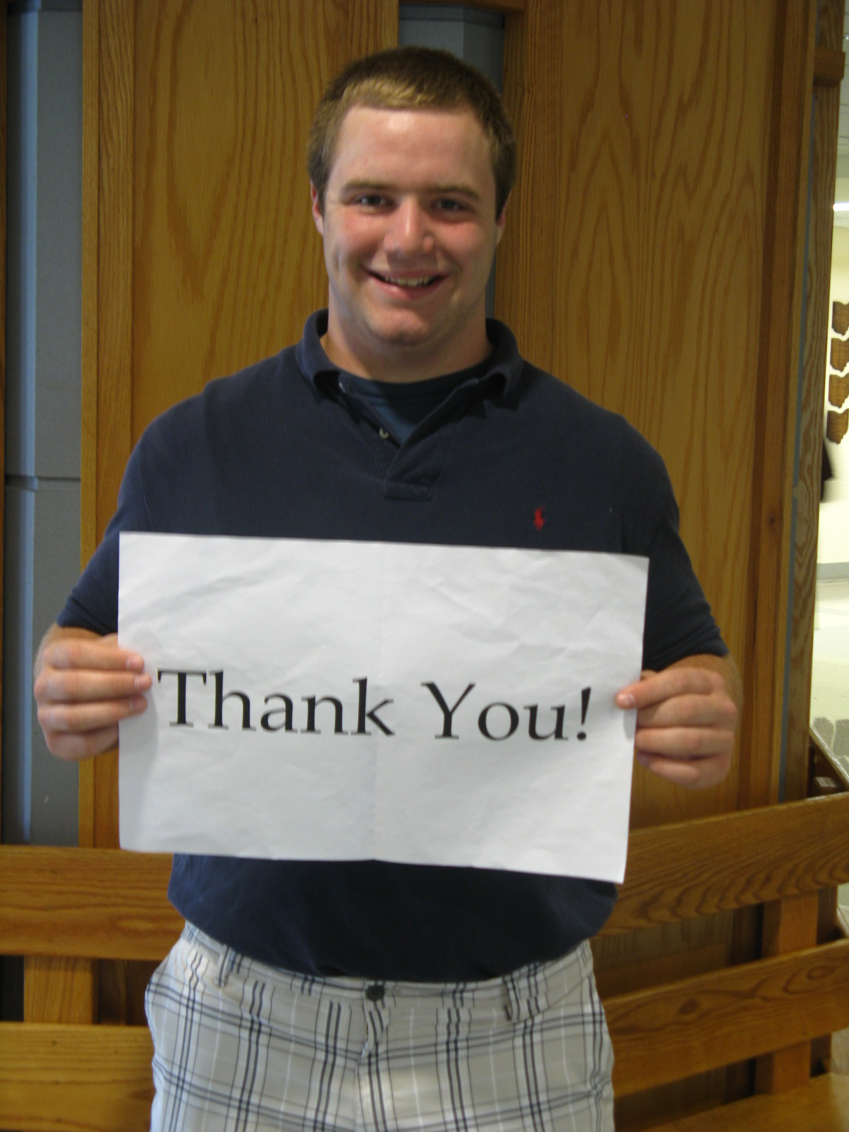

Slide 52
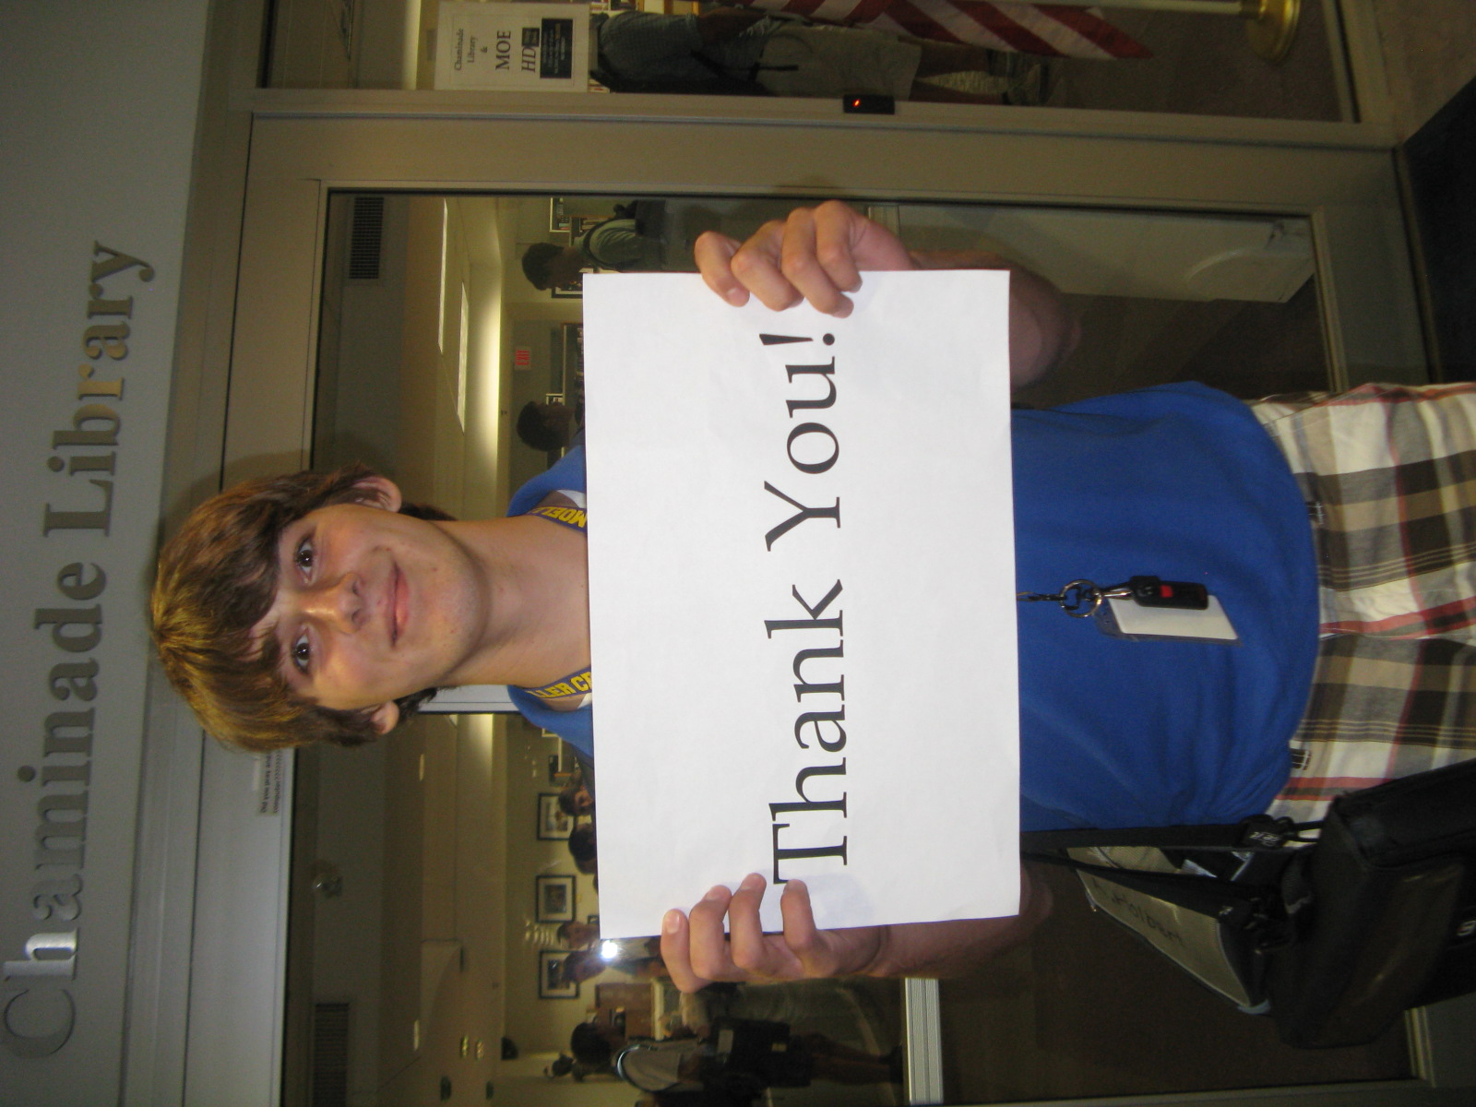

Slide 53
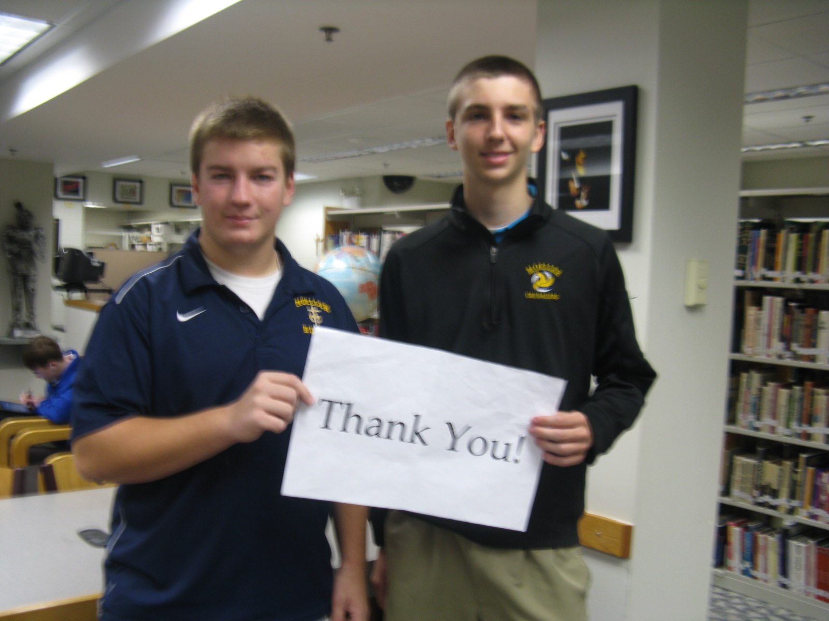

Slide 54


Slide 55


Slide 56
Special Thanks
To all Members
Of the Moeller High School
Scholarship Committee

